Slide 1
Operating System Security
Department of
York College of Pennsylvania

Slide 2
Chapter 3: roadmap
3.1 Operating Systems Concepts
3.2 Process Security
3.3 Memory and Filesystem Security
3.4 Application Program Security

Slide 3
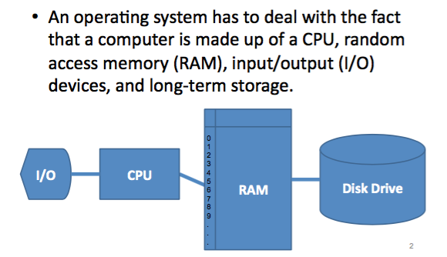
A Computer Model

Slide 4
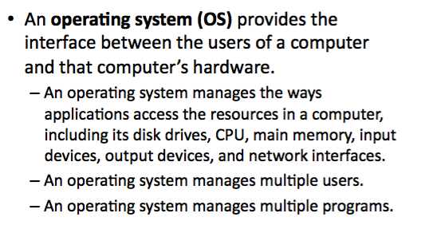
OS Concepts

Slide 5
OS Layered Design
Notes:
Operating system visualized in layers, from most critical (bottom) to least critical.

Slide 6
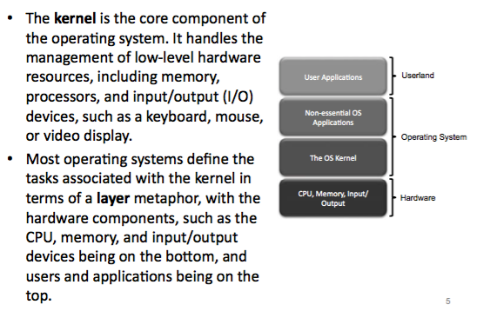
The kernel

Slide 7
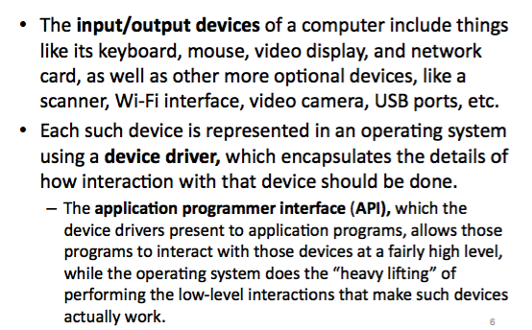
Input/Output

Slide 8
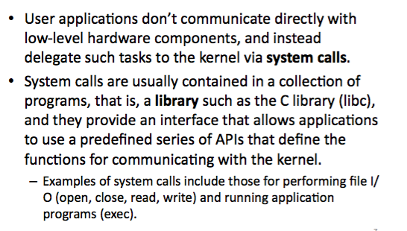
System Calls

Slide 9
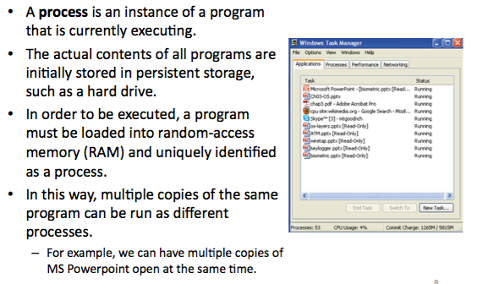
Processes

Slide 10
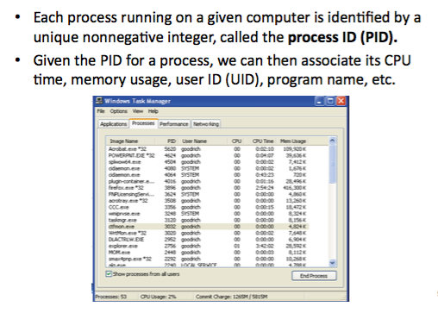
Process IDs

Slide 11
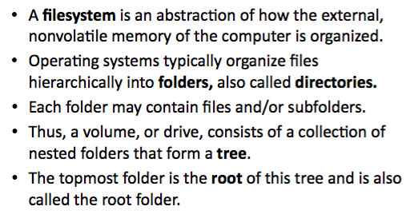
File Systems

Slide 12
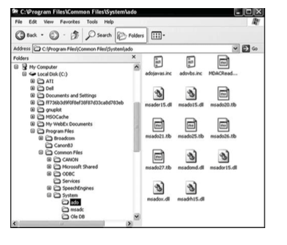
File System Example

Slide 13
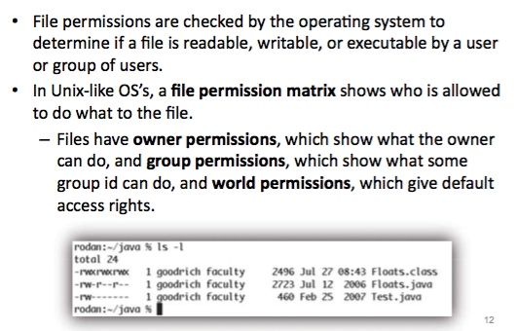
File Permissions

Slide 14
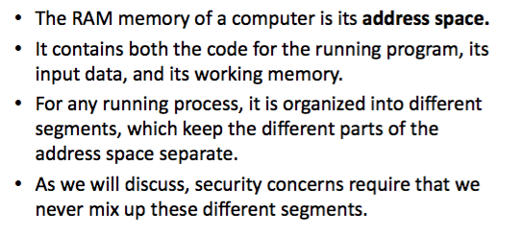
Memory Management

Slide 15
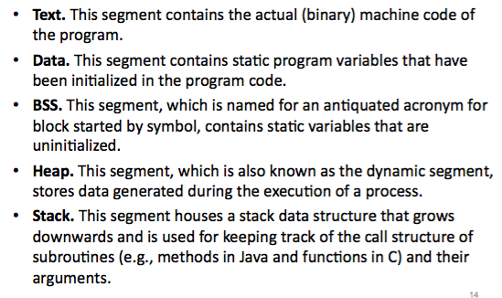
Memory Organization

Slide 16
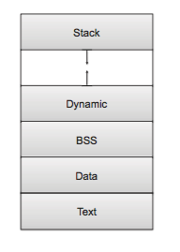
Memory Layout

Slide 17
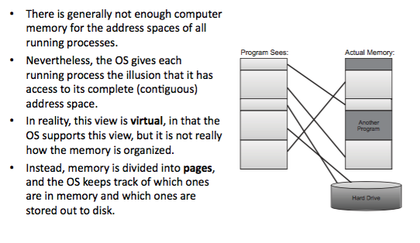
Virtual Memory

Slide 18
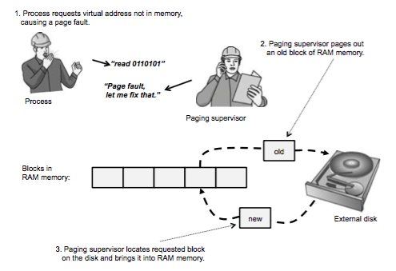
Page Faults

Slide 19
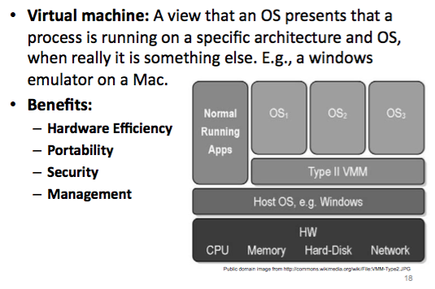
Virtual machines

Slide 20
Virtualization
With virtualization, the OS presents each user with just the resources that user should see
The user has access to a virtual machine (VM), which contains those resources
The user cannot access resources that are available to the OS but exist outside the VM
A hypervisor, or VM monitor, is the software that implements a VM
Translates access requests between the VM and the OS
Can support multiple OSs in VMs simultaneously
Honeypot: A VM meant to lure an attacker into an environment that can be both controlled and monitored
Notes:
The takeaway here is that, by acting as a sandbox, virtualization is a robust form of access control.

Slide 21
Principles of Secure OS Design
Simplicity of design
OSs are inherently complex, and any unnecessary complexity only makes them harder to understand and secure
Layered design
Enables layered trust
Layered trust
Layering is both a way to keep a design logical and understandable and a way to limit risk
Example: very tight access controls on critical OS functions, fewer access controls on important noncritical functions, and few if any access controls on functions that aren’t important to the OS

Slide 22
Kernelized Design
A kernel is the part of the OS that performs the lowest-level functions
Synchronization
Interprocess communication
Message passing
Interrupt handling
A security kernel is responsible for enforcing the security mechanisms of the entire OS
Typically contained within the kernel

Slide 23
Reference Monitor
Notes:
The reference monitor is the most important part of the security kernel, controlling access to objects. A reference monitor must be tamperproof, unbypassable, and analyzable.

Slide 24
Trusted Systems
A trusted system is one that has been shown to warrant some degree of trust that it will perform certain activities faithfully
Characteristics of a trusted system:
A defined policy that details what security qualities it enforces
Appropriate measures and mechanisms by which it can enforce security adequately
Independent scrutiny or evaluation to ensure that the mechanisms have been selected and implemented properly

Slide 25
Trusted Computing Base (TCB)
Notes:
The TCB portion of the OS is the part we depend on for enforcement of security policy. The TCB monitors and protects the secrecy and integrity of four basic interactions: process activation, execution domain switching, memory protection, and I/O operation.

Slide 26
Other Trusted System Characteristics
Secure startup
System startup is a tricky time for security, as most systems load basic I/O functionality before being able to load security functions
Trusted path
An unforgeable connection by which the user can be confident of communicating directly with the OS
Object reuse control
OS clears memory before reassigning it to ensure that leftover data doesn’t become compromised
Audit
Trusted systems track security-relevant changes, such as installation of new programs or OS modification
Audit logs must be protected against tampering and deletion
Notes:
Intel’s trusted boot technology uses TPMs to achieve secure startup.

Slide 27
Chapter 3: roadmap
3.1 Operating Systems Concepts
3.2 Process Security
3.3 Memory and Filesystem Security
3.4 Application Program Security

Slide 28
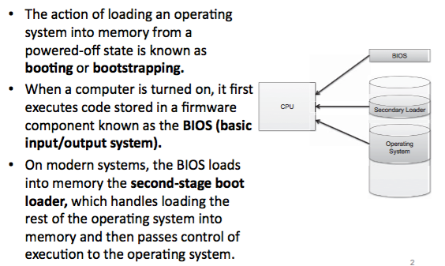
The Boot Sequence

Slide 29
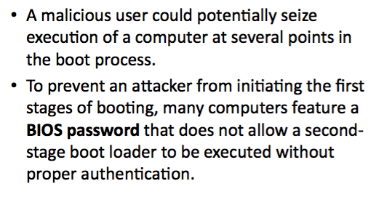
BIOS Passwords

Slide 30
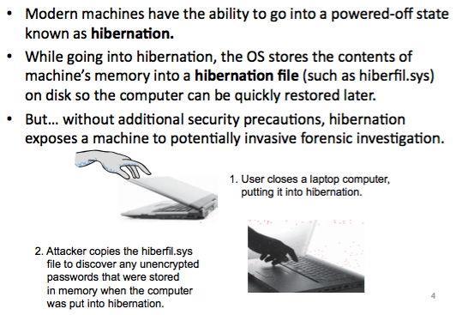
Hibernation

Slide 31
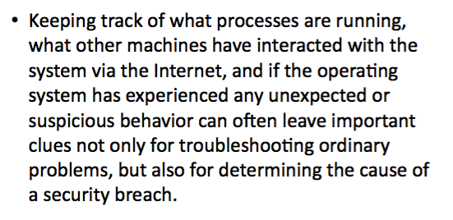
Event Logging

Slide 32
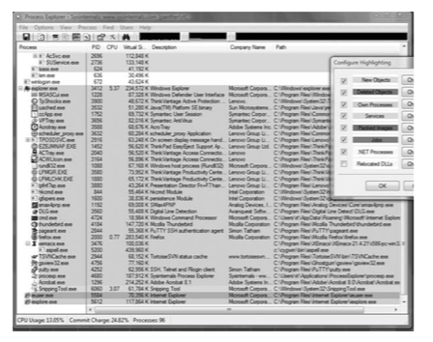
Process Explorer

Slide 33
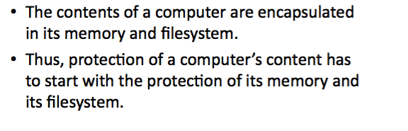
Memory and Filesystem Security

Slide 34
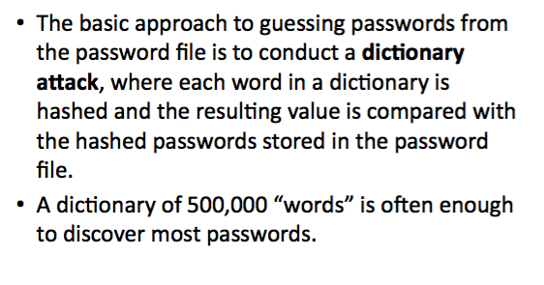
Password Security

Slide 35
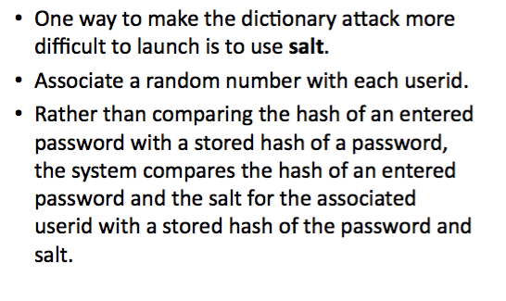
Password Salt

Slide 36
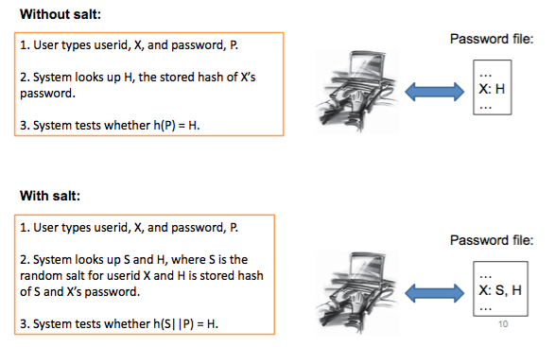
How Password Salt Works

Slide 37
Chapter 3: roadmap
3.1 Operating Systems Concepts
3.2 Process Security
3.3 Memory and Filesystem Security
3.4 Application Program Security

Slide 38
General Principles
Files and folders are managed by the operating system
Applications, including shells, access files through an API •
Access control entry (ACE)
– Allow/deny a certain type of access to a file/folder by user/group
Access control list (ACL)
– Collection of ACEs for a file/folder
A file handle provides an opaque identifier for a file/folder
File operations
– Open file: returns file handle
– Read/write/execute file
– Close file: invalidates file handle
Hierarchical file organization
– Tree(Windows) – DAG(Linux)

Slide 39
Discretionary Access Control (DAC)
Users can protect what they own
– The owner may grant access to others
– The owner may define the type of access (read/write/execute) given to others
DAC is the standard model used in operating systems
Mandatory Access Control (MAC)
– Alternative model not covered in this lecture – Multiple levels of security for users and documents – Read down and write up principles

Slide 40
Closed vs. Open Policy
Closed policy
– Also called “default secure”
Give Tom read access to “foo”
Give Bob r/w access to “bar
Tom: I would like to read “foo”
– Access allowed
Tom: I would like to read “bar”
– Access denied
Open Policy
Deny Tom read access to “foo”
Deny Bob r/w access to “bar” •
Tom: I would like to read “foo”
– Access denied
Tom: I would like to read “bar”
– Access allowed

Slide 41
Closed Policy with Negative Authorizations and Deny Priority
Give Tom r/w access to “bar”
Deny Tom write access to “bar”
Tom: I would like to read “bar”
– Access allowed
Tom: I would like to write “bar”
– Access denied
Policy is used by Windows to manage access control to the file system

Slide 42
Access Control Entries and Lists
An Access Control List (ACL) for a resource (e.g., a file or folder) is a sorted list of zero or more Access Control Entries (ACEs)
An ACE refers specifies that a certain set of accesses (e.g., read, execute and write) to the resources is allowed or denied for a user or group
Examples of ACEs for folder “Bob’s CS167 Grades”
– Bob; Read; Allow – TAs; Read; Allow – TWD; Read, Write; Allow
– Bob; Write; Deny
– TAs; Write; Allow

Slide 43
Linux vs. Windows
Linux
– Allow-only ACEs
– Access to file depends on ACL of file and of all its ancestor folders
– Start at root of file system
– Traverse path of folders
– Each folder must have execute (cd) permission
– Different paths to same file not equivalent
– File’s ACL must allow requested access
Windows
– Allow and deny ACEs
– By default, deny ACEs precede allow ones
– Access to file depends only on file’s ACL
– ACLs of ancestors ignored when access is requested
– Permissions set on a folder usually propagated to descendants (inheritance)
– System keeps track of inherited ACE’s

Slide 44
Linux File Access Control
File Access Control for:
– Files
– Directories
– Therefore... • \dev\ : devices • \mnt\ : mounted file systems • What else? Sockets, pipes, symbolic links...

Slide 45
Linux File System
Tree of directories (folders)
Each directory has links to zero or more files or directories
Hard link
– From a directory to a file
– The same file can have hard links from multiple directories, each with its own filename, but all sharing owner, group, and permissions
– File deleted when no more hard links to it
Symbolic link (symlink)
– From a directory to a target file or directory
– Stores path to target, which is traversed for each access
– The same file or directory can have multiple symlinks to it
– Removal of symlink does not affect target
– Removal of target invalidates (but not removes) symlinks to it
– Analogue of Windows shortcut or Mac OS alias

Slide 46
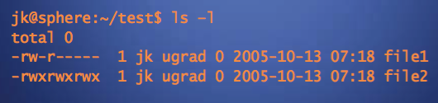
Unix Permissions
Standard for all UNIXes
Every file is owned by a user and has an associated group
Permissions often displayed in compact 10-character notation
To see permissions, use ls–l

Slide 47
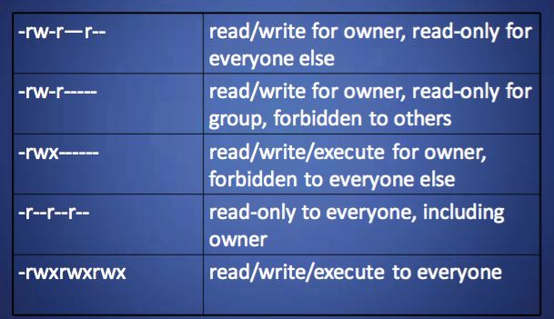
Permissions Examples (Regular Files)

Slide 48
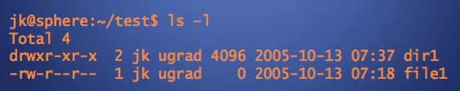
Permissions for Directories
Permissions bits interpreted differently for directories
Read bit allows listing names of files in directory, but not their properties like size and permissions
Write bit allows creating and deleting files within the directory
Execute bit allows entering the directory and getting
properties of files in the directory
Lines for directories in ls –l output begin with d, as below:

Slide 49
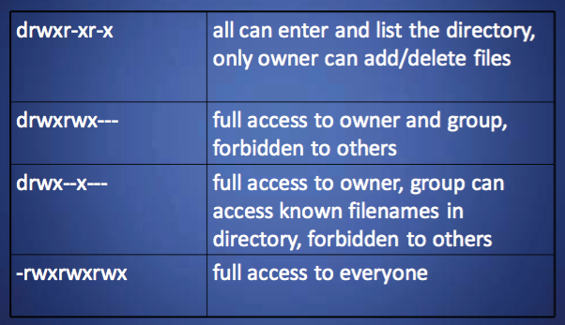
Permissions Examples (Directories)

Slide 50
Root
“root” account is a super-user account, like Administrator on Windows
Multiple roots possible
File permissions do not restrict root
This is dangerous, but necessary, and OK with good practices

Slide 51
Becoming Root
su
– Changes home directory, PATH, and shell to that of root, but doesn’t touch most of environment and doesn’t run login scripts
su-
– Logs in as root just as if root had done so normally
sudo <command>
– Run just one command as root
su [-] <user>
– Become another non-root user – Root does not require to enter password

Slide 52
Chapter 3: roadmap
3.1 Operating Systems Concepts
3.2 Process Security
3.3 Memory and Filesystem Security
3.4 Application Program Security

Slide 53
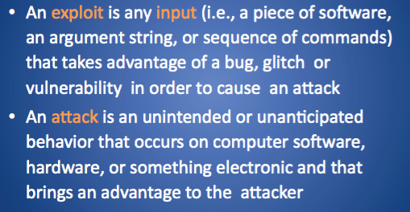
What is an Exploit?

Slide 54
Buffer Overflow
A very common attack mechanism
First widely used by the Morris Worm in 1988
Prevention techniques known
Still of major concern
Legacy of buggy code in widely deployed operating systems and applications
Continued careless programming practices by programmers
Notes:
We begin with an introduction to the basics of buffer overflow. Then we
present details of the classic stack buffer overflow. This includes a discussion of
how functions store their local variables on the stack and the consequence of
attempting to store more data in them than there is space available. We continue
with an overview of the purpose and design of shellcode, which is the custom code
injected by an attacker and to which control is transferred as a result of the buffer
overflow.
Next we consider ways of defending against buffer overflow attacks. We start
with the obvious approach of preventing them by not writing code that is vulnerable
to buffer overflows in the first place. However, given the large, existing body
of buggy code, we also need to consider hardware and software mechanisms that
can detect and thwart buffer overflow attacks. These include mechanisms to protect
executable address space, techniques to detect stack modifications, and approaches
that randomize the address space layout to hinder successful execution of these
attacks.
Finally, we briefly survey some of the other overflow techniques, including
return to system call and heap overflows, and mention defenses against these.

Slide 55
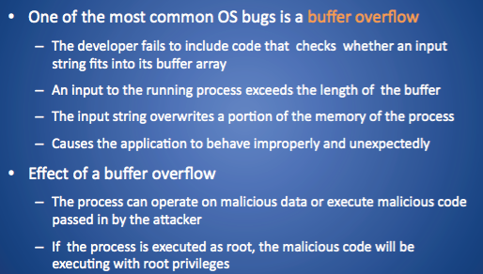
Buffer Overflow Attack

Slide 56
Buffer Overflow Basics
Programming error when a process attempts to store data beyond the limits of a fixed-sized buffer
Overwrites adjacent memory locations
Locations could hold other program variables, parameters, or program control flow data
Buffer could be located on the stack, in the heap, or in the data section of the process
Execution of code chosen by attacker
Memory access violations
Unexpected transfer of control
Corruption of program data
Consequences:
Notes:
A buffer overflow can occur as a result of a programming error when a process
attempts to store data beyond the limits of a fixed-sized buffer and consequently
overwrites adjacent memory locations. These locations could hold other program
variables or parameters or program control flow data such as return addresses and
pointers to previous stack frames. The buffer could be located on the stack, in the
heap, or in the data section of the process. The consequences of this error include
corruption of data used by the program, unexpected transfer of control in the program,
possibly memory access violations, and very likely eventual program termination.
When done deliberately as part of an attack on a system, the transfer of control
could be to code of the attacker’s choosing, resulting in the ability to execute arbitrary
code with the privileges of the attacked process.

Slide 57
Basic Buffer Overflow Example

Slide 58
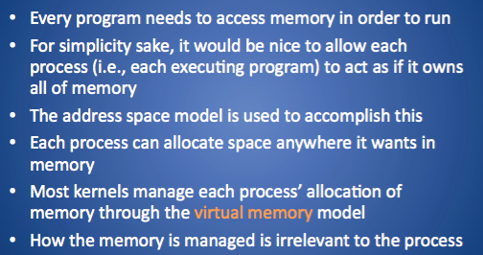
Address Space

Slide 59
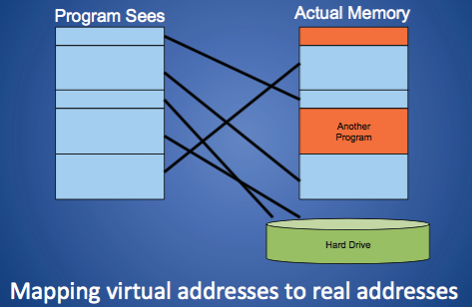
Virtual Memory

Slide 60
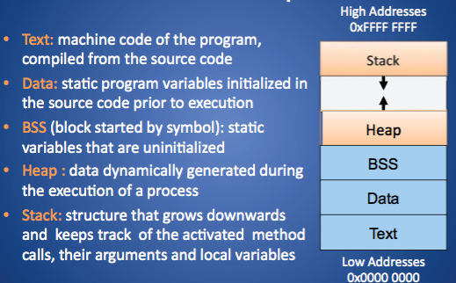
Unix Address Space

Slide 61
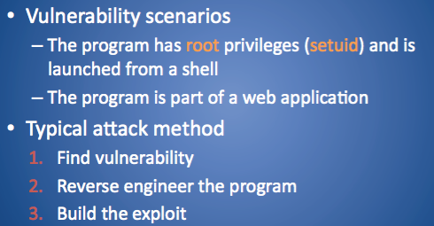
Vulnerabilities and Attack method

Slide 62
Buffer Overflow Attacks
To exploit a buffer overflow an attacker needs:
To identify a buffer overflow vulnerability in some program that can be triggered using externally sourced data under the attacker’s control
To understand how that buffer is stored in memory and determine potential for corruption
Identifying vulnerable programs can be done by:
Inspection of program source
Tracing the execution of programs as they process oversized input
Using tools such as fuzzing to automatically identify potentially vulnerable programs
Notes:
To exploit any type of buffer overflow, such as those we have illustrated here,
the attacker needs
1. To identify a buffer overflow vulnerability in some program that can be
triggered using externally sourced data under the attackers control, and
2. To understand how that buffer will be stored in the processes memory, and
hence the potential for corrupting adjacent memory locations and potentially
altering the flow of execution of the program.
Identifying vulnerable programs may be done by inspection of program
source, tracing the execution of programs as they process oversized input, or using
tools such as fuzzing , which we discuss in Chapter 11 .2, to automatically identify
potentially vulnerable programs. What the attacker does with the resulting corruption
of memory varies considerably, depending on what values are being overwritten.
We will explore some of the alternatives in the following sections.

Slide 63
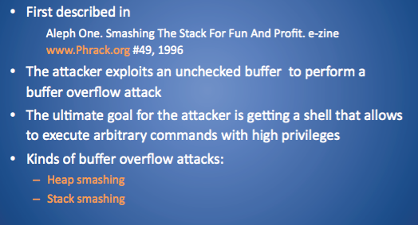
Buffer Overflow Attack in a Nutshell

Slide 64
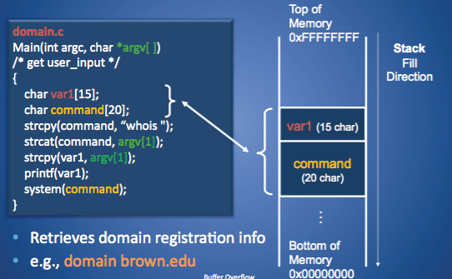
Buffer Overflow

Slide 65
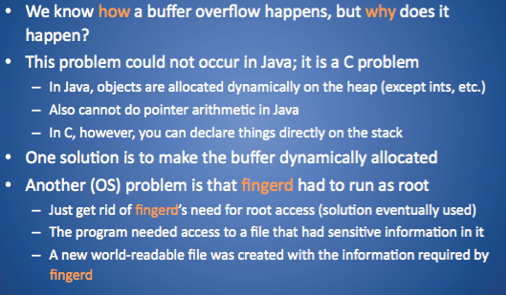
Buffer Overflow Mitigation

Slide 66
Overflow Countermeasures
Staying within bounds
Check lengths before writing
Confirm that array subscripts are within limits
Double-check boundary condition code for off-by-one errors
Limit input to the number of acceptable characters
Limit programs’ privileges to reduce potential harm
Many languages have overflow protections
Code analyzers can identify many overflow vulnerabilities
Canary values in stack to signal modification

Slide 67
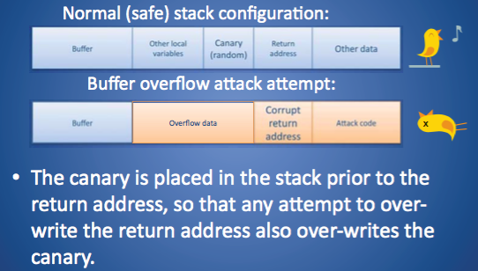
Stack-based buffer overflow detection using a random canary

Slide 68
Run-Time Defenses: Address Space Randomization
Manipulate location of key data structures
Stack, heap, global data
Using random shift for each process
Large address range on modern systems means wasting some has negligible impact
Randomize location of heap buffers
Random location of standard library functions
Notes:
Another run-time technique that can be used
to thwart attacks involves manipulation of the location of key data structures in a
processes address space. In particular, recall that in order to implement the classic
stack overflow attack, the attacker needs to be able to predict the approximate
location of the targeted buffer. The attacker uses this predicted address to determine
a suitable return address to use in the attack to transfer control to the shellcode. One
technique to greatly increase the difficulty of this prediction is to change the address
at which the stack is located in a random manner for each process. The range of
addresses available on modern processors is large (32 bits), and most programs only
need a small fraction of that. Therefore, moving the stack memory region around by
a megabyte or so has minimal impact on most programs but makes predicting the
targeted buffer’s address almost impossible. This amount of variation is also much
larger than the size of most vulnerable buffers, so there is no chance of having a large
enough NOP sled to handle this range of addresses. Again this provides a degree of
protection for existing programs, and while it cannot stop the attack proceeding, the
program will almost certainly abort due to an invalid memory reference.
Related to this approach is the use of random dynamic memory allocation (for
malloc() and related library routines). As we discuss in Section 10.3 , there is a
class of heap buffer overflow attacks that exploit the expected proximity of successive
memory allocations, or indeed the arrangement of the heap management data
structures. Randomizing the allocation of memory on the heap makes the possibility
of predicting the address of targeted buffers extremely difficult, thus thwarting
the successful execution of some heap overflow attacks.
Another target of attack is the location of standard library routines. In an
attempt to bypass protections such as nonexecutable stacks, some buffer overflow
variants exploit existing code in standard libraries. These are typically loaded at
the same address by the same program. To counter this form of attack, we can use
a security extension that randomizes the order of loading standard libraries by a
program and their virtual memory address locations. This makes the address of any
specific function sufficiently unpredictable as to render the chance of a given attack
correctly predicting its address, very low.
The OpenBSD system includes versions of all of these extensions in its technological
support for a secure system.

Slide 69
Run-Time Defenses: Guard Pages
Place guard pages between critical regions of memory
Flagged in MMU as illegal addresses
Any attempted access aborts process
Further extension places guard pages Between stack frames and heap buffers
Cost in execution time to support the large number of page mappings necessary
Notes:
A final runtime technique that can be used places guard pages
between critical regions of memory in a processes address space. Again, this
exploits the fact that a process has much more virtual memory available than
it typically needs. Gaps are placed between the ranges of addresses used for each
of the components of the address space, as was illustrated in Figure 10.4 . These
gaps, or guard pages, are flagged in the MMU as illegal addresses, and any attempt
to access them results in the process being aborted. This can prevent buffer
overflow attacks, typically of global data, which attempt to overwrite adjacent
regions in the processes address space, such as the global offset table, as we discuss
in Section 10.3 .
A further extension places guard pages between stack frames or between different
allocations on the heap. This can provide further protection against stack and
heap over flow attacks, but at cost in execution time supporting the large number of
page mappings necessary.

Slide 70

Q&A

